Slide 1
BCNN Code Review & Operation Skipping Scheme
2016124103 박상준

Slide 2


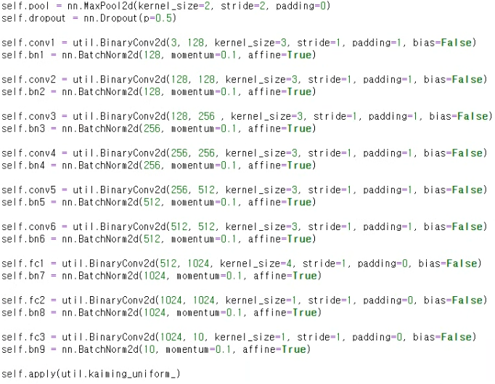

Python
Original ConvNet Model
BinaryConv2d (conv1~6)
kernel size : 3
Stride : 1
Padding : 1
MaxPool2d
Kernel size : 2
Stride : 2
Padding : 0
Weight initialization : kaiming uniform

Slide 3
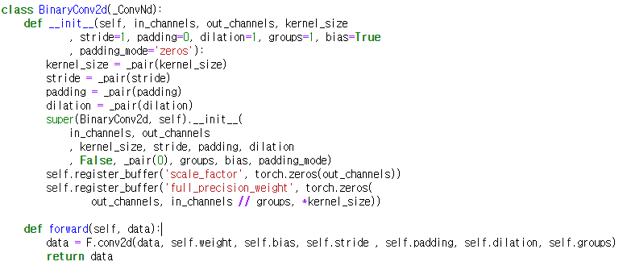
Python
BinaryConv2d = torch.nn.modules.conv
Buffers for scale factor,
full precision weight

Slide 4
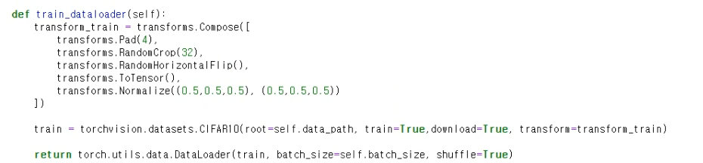
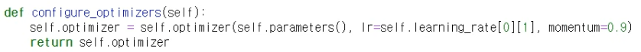

Python
Torch Lightning Module Setup : Training Setup
Load Dataset
Set Optimizer
-1 ~ 1 normalize

Slide 5


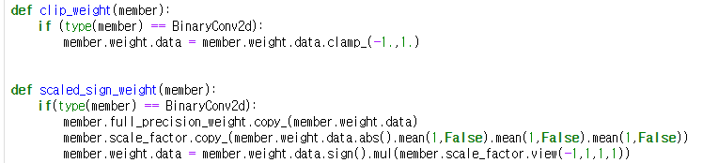

Python
Torch Lightning Module Setup : Forward
Save full precision weight
Calculate scale factor

Slide 6


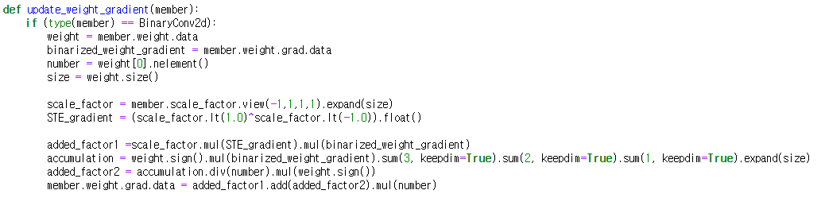
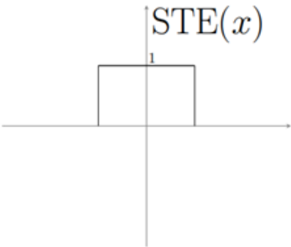
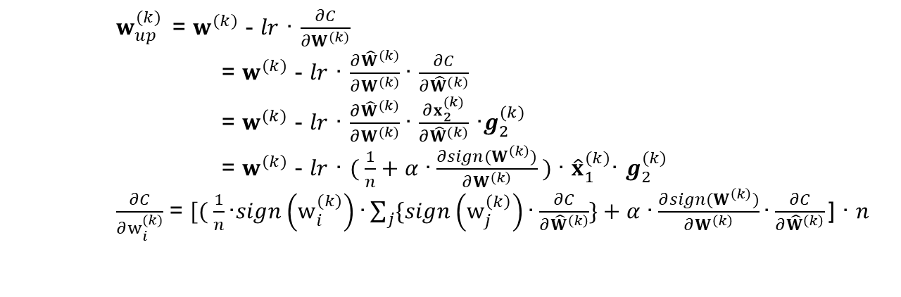
Python
Torch Lightning Module Setup : Update Weight Gradient
$w_{up}^{(k)}$= $w^{(k)}$ - $lr$ · $\frac{∂C}{∂W^{(k)}}$
= $w^{(k)}$ - $lr$ · $\frac{∂{\hat{W}}^{(k)}}{∂W^{(k)}}$· $\frac{∂C}{∂{\hat{W}}^{(k)}}$
= $w^{(k)}$ - $lr$ · $\frac{∂{\hat{W}}^{(k)}}{∂W^{(k)}}$· $\frac{∂x_{2}^{(k)}}{∂{\hat{W}}^{(k)}}$ ·$g_{2}^{(k)}$
= $w^{(k)}$ - $lr$ · $( \frac{1}{n}+α \text{·}\frac{∂{sign(W}^{\left(k\right)})}{∂W^{\left(k\right)}} )$· ${\hat{x}}_{1}^{(k)}$· $g_{2}^{(k)}$
$\frac{∂C}{∂w_{i}^{(k)}}$ = $[( \frac{1}{n}\text{·}sign\left(w_{i}^{(k)}\right)\text{·}\sum_{j}{\{sign\left(w_{j}^{\left(k\right)}\right)\text{·}\frac{∂C}{∂{\hat{W}}^{\left(k\right)}}\}}+α \text{·}\frac{∂{sign(W}^{\left(k\right)})}{∂W^{\left(k\right)}}\text{·}\frac{∂C}{∂{\hat{W}}^{\left(k\right)}}\text{] · }n$
binarized_weight_gradient
STE_gradient
added_factor2
accumulation
added_factor1

Slide 7
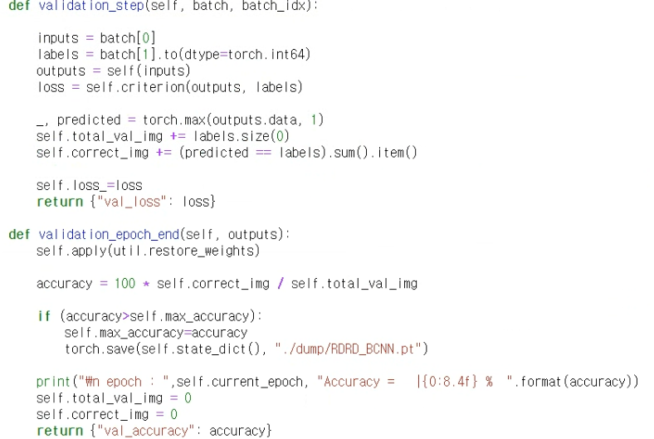
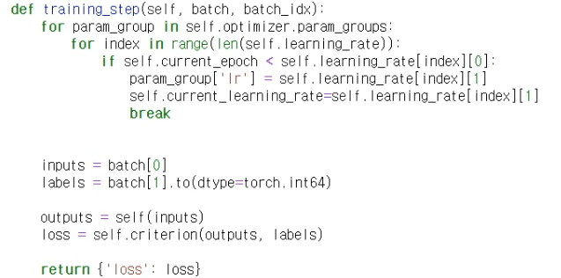
Python
Torch Lightning Module Setup : Training step

Slide 8
Dump Parameters
Dump Element
I_hat_block1~9.bin
First Layer : -1~1 value → 0~255 value → byte → dump with redundant channel
Other Layer : data.ge(0) → np.packbits → dump (same with O_hat_block)
F_hat_block1~9.bin
First Layer : weight.ge(0) → np.packbits → dump with redundant channel
Other Layer : weight.ge(0) → np.packbits → dump
O_hat_block1~9.bin
Other Layer : data.ge(0) → np.packbits → dump (same with I_hat_block)
Last Layer : int → dump
bn_scale_factor.bin / bn_bias_factor.bin
T1~9.bin
int16

Slide 9
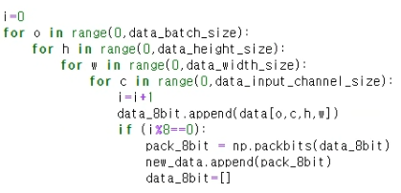
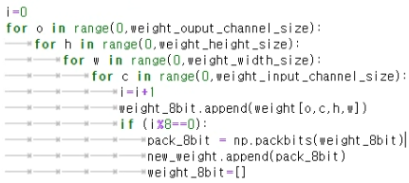








Dump Parameters
Dump : Other Layer
I_hat_block{}.bin F_hat_block{}.bin
$$c’’$$
1
1
4
np.packbits(a)
Binary array → uint8 array (packing)
$$c$$
$$c$$
$$w$$
$$w’’$$
2
2
$$h$$
$$h’’$$
3
$$\hat{I}$$
3
$$\hat{F}$$

Slide 10
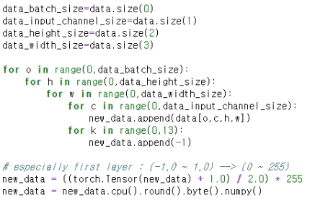
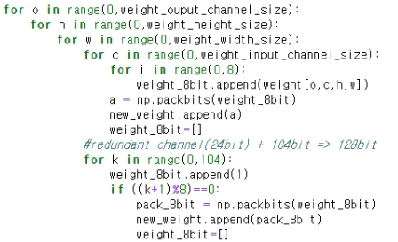







Dump Parameters
Dump : First Layer
I_hat_block1.bin F_hat_block1.bin
$$c’’$$
104
104
$$c$$
1
$$c′′$$
1
24
1
24
$$0$$
$$w$$
2
$$w′′$$
2
$$h$$
$h$’’
3
$$\hat{I}$$
3
$$\hat{F}$$

Slide 11
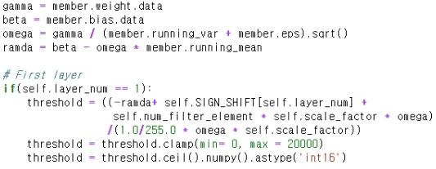
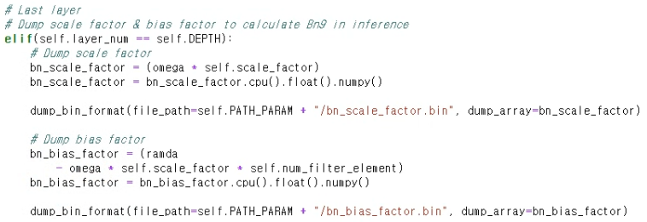
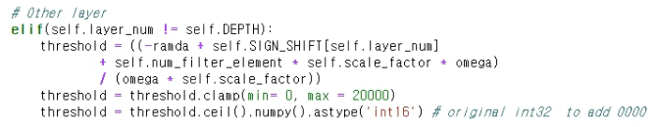
Dump Parameters
Dump : Threshold & scale, bias factor for BN

Slide 12
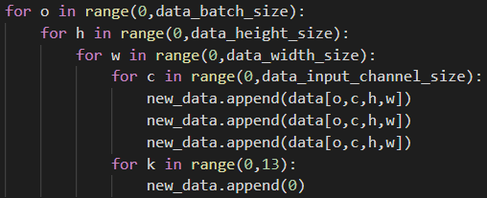
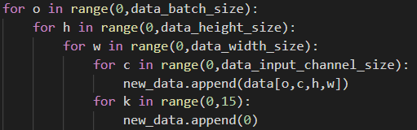

















Dump Parameters
Dump.py for Radar Dataset (gray scale)
Radar dataset
original (input channel : 3) → proposed(input channel : 1)
$$c’’$$
$$c’’$$
104
104
$$c$$
1
$$c$$
1
120
1
120
1
24
24
1
$$c$$
$$c$$
$$1$$
$$0$$
8
$$1$$
8
$$0$$
$$w$$
2
$$w′′$$
2
$$w$$
2
$$w′′$$
2
$$h$$
$h$’’
$$h$$
$$h′′$$
3
$$\hat{I}$$
3
$$\hat{F}$$
$$\hat{I}$$
$$\hat{F}$$
3
3

Slide 13
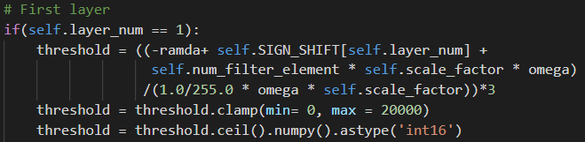
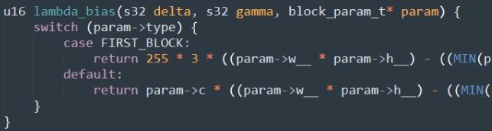
Dump Parameters
Dump.py for Radar Dataset (gray scale)

Slide 14
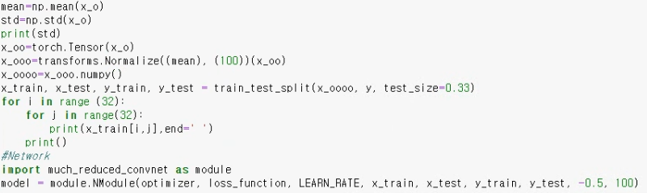
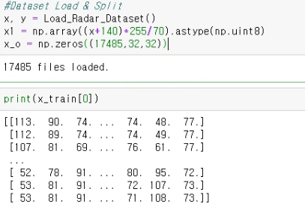
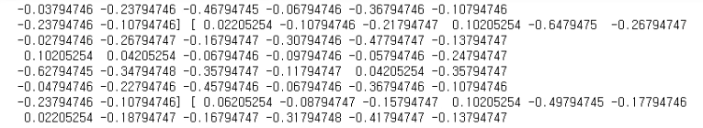


Dump Parameters
Dump.py for Radar Dataset (gray scale)
Radar dataset
Gray scale, value = 0~255 → value : -1~1 (transforms.Normalize)
Accuracy : 94.247% =

Slide 15



Operation Skipping Scheme for BCNN
Boundary Skipping
Skips the operations with respect to the padded zeros off the boundary.
...
$$α$$
...
$$α$$
$$α$$
$$α$$
Effective receptive
field
Weight
Input feature
◎
◎ : XNOR-Popcount
...
Skipped !
◎
Start op.

Slide 16



Operation Skipping Scheme for BCNN
Boundary Skipping
Calculating Receptive field’s parameters (u, v)
Weighted Sum or XNOR popcount in receptive field
gamma
delta
$$u=0,1$$
$$v=0,1$$
$$u=−1,0,1$$
$$v=0,1$$
$$u=0,1$$
$$v=−1,0,1$$

Slide 17



Operation Skipping Scheme for BCNN
Early Detection of +1
When the result bit is determined as ‘+1’, redundant operations are skipped.
w
Receptive field
w''
w
w'
c
...
...
1
Don’t
care
$$α$$
$$α$$
h''
1
h
h'
...
$$α$$
...
$$α$$
Maxpool window
Output feature
h
Intermediate feature
Weight
Input feature
◎ ➔ ◇ > Threshold ? No (Continue op.)
◎ : XNOR-Popcount
◇ : XNOR-Popcount result
◆ : Accumulated XNOR-Popcount result
◎ ➔ ◆ + ◇ > Threshold ? Yes (Skip the redundant op.)
...

Slide 18
Operation Skipping Scheme for BCNN
Early Detection of 0
When the result bit is determined as ‘0’, redundant operations are skipped.
w
Receptive field
w''
w
c
...
...
0
$$α$$
$$α$$
h''
h
...
$$α$$
...
$$α$$
h
Intermediate feature
Weight
Input feature
◎ ➔ ◇ + (N-1) $∙α$ < Threshold ? No (Continue op.)
◎ : XNOR-Popcount
◇ : XNOR-Popcount result
◆ : Accumulated XNOR-Popcount result
N : Total number of iterations in receptive field
◎ ➔ ◆ + ◇ + (N-2) $∙α$ < ? Yes (Skip the redundant op.)
...

Slide 19
Operation Skipping Scheme for BCNN
Early Detection of 0
Calculate N (Total number of iterations in receptive field)
Skipping redundant operations
First block
Other blocks
Number of Iterations Remain

Slide 20
Operation Skipping Scheme for BCNN
Locality-Exploiting Maxpooling
If the result bit is determined as ‘1’ in the previous maxpooling window
The operation starts from the closest position from the position of the previous ‘1’ bit in the next window.
w
: Position of the 1st nearest element from bit ‘1’
: Position of the 2nd nearest element from bit ‘1’
1
1
: Position of the 3rd nearest element from bit ‘1’
h
: Position of the 4th nearest element from bit ‘1’
current
next
: Order of operation in the maxpooling window
1
1
Intermediate feature

Slide 21
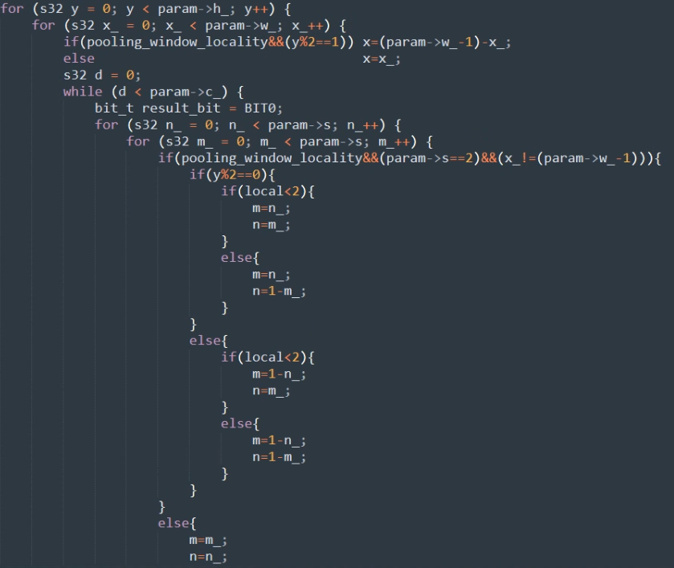


Operation Skipping Scheme for BCNN
Locality-Exploiting Maxpooling
m
1 1
n
x
1 1
y
1 1
$$\hat{O}$$
1 1
$$\hat{I}$$

Slide 22
Operation Skipping Scheme for BCNN
Early Detection of +1, -1 Skipping
Accuracy : 89.54% (CIFAR 10)
Block | Input Feature size (bits) | Weight size (bits) | Pooling stride | Cycle count (No OP Skipping) | Cycle count (Boundary op skip + Bit 1 skip + Bit 0 skip) | Reduction rate (%)
1 | 32 x 32 x 128 | 3 x 3 x 128 x 128 | - | 1179648 | 1100500 | 6.70
2 | 32 x 32 x 128 | 3 x 3 x 128 x 128 | 2 | 1179648 | 809546 | 31.37
3 | 16 x 16 x 128 | 3 x 3 x 128 x 256 | - | 589824 | 530768 | 10.01
4 | 16 x 16 x 256 | 3 x 3 x 256 x 256 | 2 | 1179648 | 747959 | 36.52
5 | 8 x 8 x 256 | 3 x 3 x 256 x 512 | - | 589824 | 477998 | 18.95
6 | 8 x 8 x 512 | 3 x 3 x 512 x 512 | 2 | 1179648 | 666561 | 43.49
7 | 1 x 1 x 8192 | 1 x 1 x 8192 x 1024 | - | 65536 | 64758 | 1.18
8 | 1 x 1 x 1024 | 1 x 1 x 1024 x 1024 | - | 8192 | 7875 | 3.86
9 | 1 x 1 x 1024 | 1 x 1 x 1024 x 10 | - | 80 | 80 | -
Total |  |  |  | 5972048 | 4406045 | 26.22

Slide 23
Operation Skipping Scheme for BCNN
Locality-Exploiting Maxpooling
Accuracy : 89.54% (CIFAR 10)
Block | Input Feature size (bits) | Weight size (bits) | Pooling stride | Cycle count (Boundary op skip + Bit 1 skip + Bit 0 skip) | Cycle count (skippings+ Locality-Exploiting Maxpooling) | Reduction rate (%)
1 | 32 x 32 x 128 | 3 x 3 x 128 x 128 | - | 1100500 | 1100500 | -
2 | 32 x 32 x 128 | 3 x 3 x 128 x 128 | 2 | 809546 | 807067 | 0.3
3 | 16 x 16 x 128 | 3 x 3 x 128 x 256 | - | 530768 | 530768 | -
4 | 16 x 16 x 256 | 3 x 3 x 256 x 256 | 2 | 747959 | 745965 | 0.2
5 | 8 x 8 x 256 | 3 x 3 x 256 x 512 | - | 477998 | 477998 | -
6 | 8 x 8 x 512 | 3 x 3 x 512 x 512 | 2 | 666561 | 641704 | 3.72
7 | 1 x 1 x 8192 | 1 x 1 x 8192 x 1024 | - | 64758 | 64758 | -
8 | 1 x 1 x 1024 | 1 x 1 x 1024 x 1024 | - | 7875 | 7875 | -
9 | 1 x 1 x 1024 | 1 x 1 x 1024 x 10 | - | 80 | 80 | -
Total |  |  |  | 4406045 | 4376715 | 0.66

Slide 24
Operation Skipping Scheme for BCNN
No Operation Skipping vs. with Operation Skipping
Accuracy : 89.54% (CIFAR 10)
Block | Input Feature size (bits) | Weight size (bits) | Pooling stride | Cycle count (No OP Skipping) | Cycle count (OP Skipping) | Reduction rate (%)
1 | 32 x 32 x 128 | 3 x 3 x 128 x 128 | - | 1179648 | 1100500 | 6.70
2 | 32 x 32 x 128 | 3 x 3 x 128 x 128 | 2 | 1179648 | 807067 | 31.58
3 | 16 x 16 x 128 | 3 x 3 x 128 x 256 | - | 589824 | 530768 | 10.01
4 | 16 x 16 x 256 | 3 x 3 x 256 x 256 | 2 | 1179648 | 745965 | 36.76
5 | 8 x 8 x 256 | 3 x 3 x 256 x 512 | - | 589824 | 477998 | 18.95
6 | 8 x 8 x 512 | 3 x 3 x 512 x 512 | 2 | 1179648 | 641704 | 45.60
7 | 1 x 1 x 8192 | 1 x 1 x 8192 x 1024 | - | 65536 | 64758 | 1.18
8 | 1 x 1 x 1024 | 1 x 1 x 1024 x 1024 | - | 8192 | 7875 | 3.86
9 | 1 x 1 x 1024 | 1 x 1 x 1024 x 10 | - | 80 | 80 | -
Total |  |  |  | 5972048 | 4376715 | 26.71

